Slide 1
Opportunity Hack 2018
Team: Trevor Moore, Jordan Riley, Stone Sommers, Carter Rice & Kyle DeHart

Slide 2
Company: Name Problem: Business Problem
Solution:
Solution talking point 1
Solution talking point 2
Solution talking point 3

Slide 3






Architecture Decisions:
IDE: Eclipse
Framework/Open Source Tech.: Spring MVC, Spring Beans, Apache Tiles, Bootstrap, jQuery, Eclipse IDE, among others…
Back-end: Java, JDBC API
Front-end: HTML, CSS, JavaScript (incorporating Bootstrap and jQuery libraries)
Hosting Service: Heroku
Database: MySQL

Slide 4
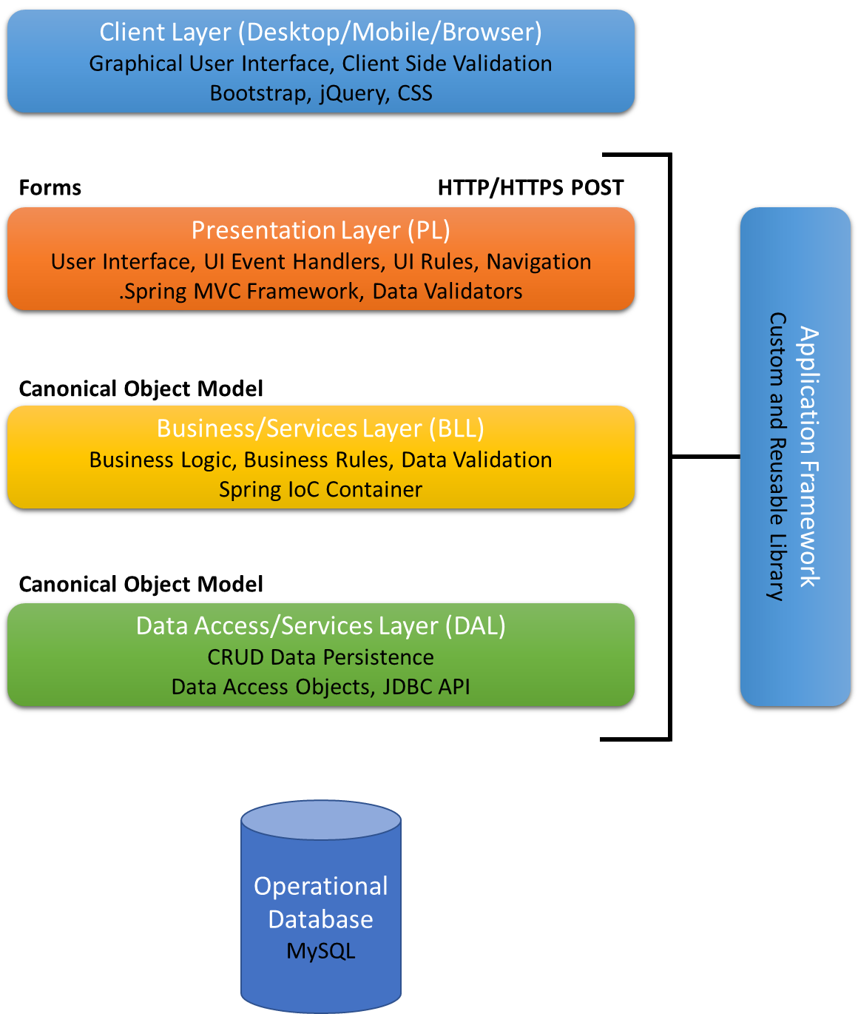
Architecture Decisions (cont.):
N-Layer Architecture:
Presentation Layer (.jsp files/our views)
Business Services Layer (controllers and business logic)
Data Access Layer (database objects and connection classes)
Inversion of Control:
Utilized dependency injection to inject all our data objects and services using Spring’s IoC Container

Slide 5
Design Decisions:
Insert sitemap diagram here…

Slide 6
Design Decisions (cont.):
Insert low fidelity wireframes here…

Slide 7
Cost:
Figure out cost of how much Heroku will cost on an annual basis.

Slide 8
How Our App Will Work:
Insert Screenshots Here
User Experience:
Describe user experience/flow of the app
How managers will add employees to system
How employees will register and login to system
How managers and employees will utilize each function (1)
How managers and employees will utilize each function (2)
How managers and employees will utilize each function (3)
How managers and employees will utilize each function (4)
How managers and employees will utilize each function (5)

Slide 9
Module 1
Screenshots here…

Slide 10
Module 2
Screenshots here…

Slide 11
Module 3
Screenshots here…

Slide 12
Module 4
Screenshots here…

Slide 13
Module 5
Screenshots here…

Slide 14
How our App solves Company’s Problem:
Solution:
Solution talking point 1
Solution talking point 2
Solution talking point 3
Cost talking point

Slide 15
Demo…
opportunityhack.herokuapp.com

Slide 16
Questions?

